Slide 1
my favorite book
HANNA KĄDZIOŁKA

Slide 2
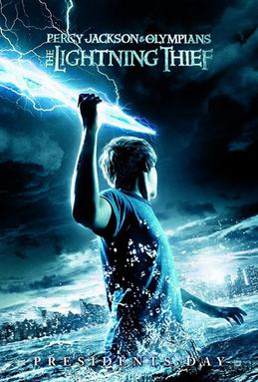
‘Percy Jackson- Lightning Thief’ is my favorite book.
I read this book 2 years ago, it took me 6 days. This is my favorite book because it intrigued me more than other books.

Slide 3
The Lightning Thief is a fantasy novel about a modern day, 12-year-old boy who finds out that his real father is Poseidon, the Greek god of the seas. Percy decides to become a hero by taking an expedition across the United States to find the entrance to the Underworld and stop the war between the gods.

Slide 4
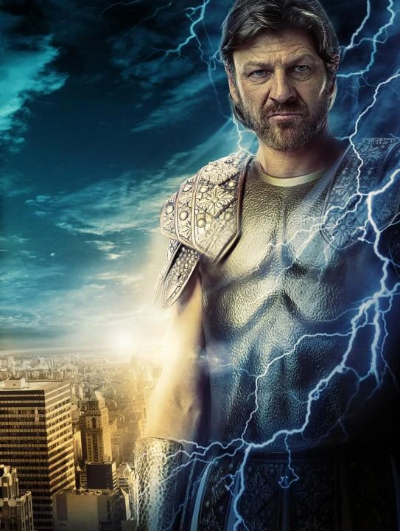
Percy, immediately after learning the truth, is set out on an extremely dangerous mission. With the help of a Satyr and his daughter Athena, Percy travels across the United States to catch a thief who has stolen an ancient "weapon of mass destruction" - Zeus thunderbolt. Along the way, he will face hosts of mythological monsters whose task is to stop him. And most of all, he will have to face
a father he has never met before

Slide 5
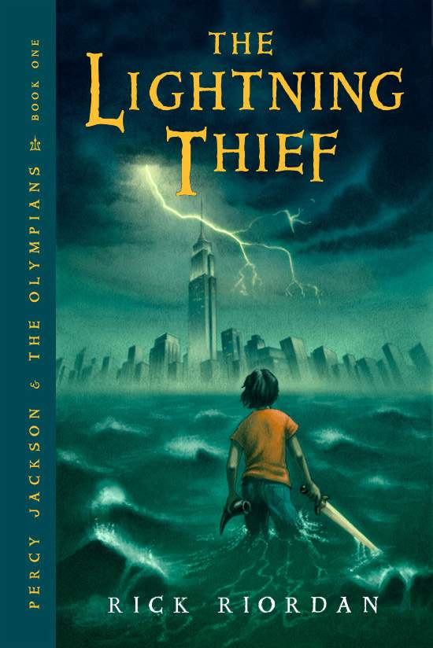
The novel is an interesting, humorous introduction to Greek myths. It works well when taught in conjunction with mythology, which is a core element of most state English curricula. The novel can also be taught at any time after the introduction of Greek mythology.

Slide 6
Rick Riordan, the author, has fifteen years of experience as a middle school English teacher. He designed The Lightning Thief as suitable reading for children between the ages of nine and fourteen.

