Slide 1
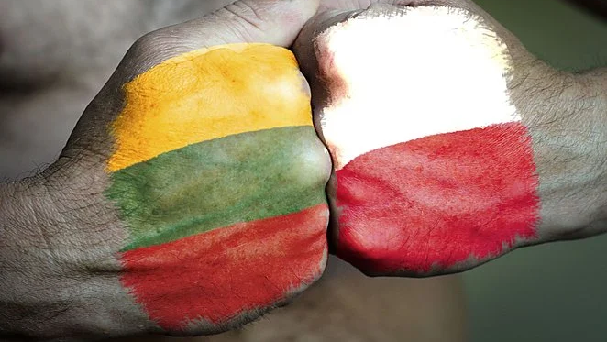
Historical connections between Poland and Lithuania
By Leon Stepaniak

Slide 2
How it started?
The beginnings of the history of relations between these countries dates back to the 13th century, when the country united by Mindaugas, having seized part of Ruthenia, got into the first neighborly disputes with Polish princes. The era of mutual fights and invasions, although briefly interrupted by the alliance of Władysław Łokietek with Gediminas, lasted in practice until 1385, when the first Polish-Lithuanian personal union was concluded - the union in Krewo - is often interpreted as an act of incorporation of Lithuania by Poland.

Slide 3
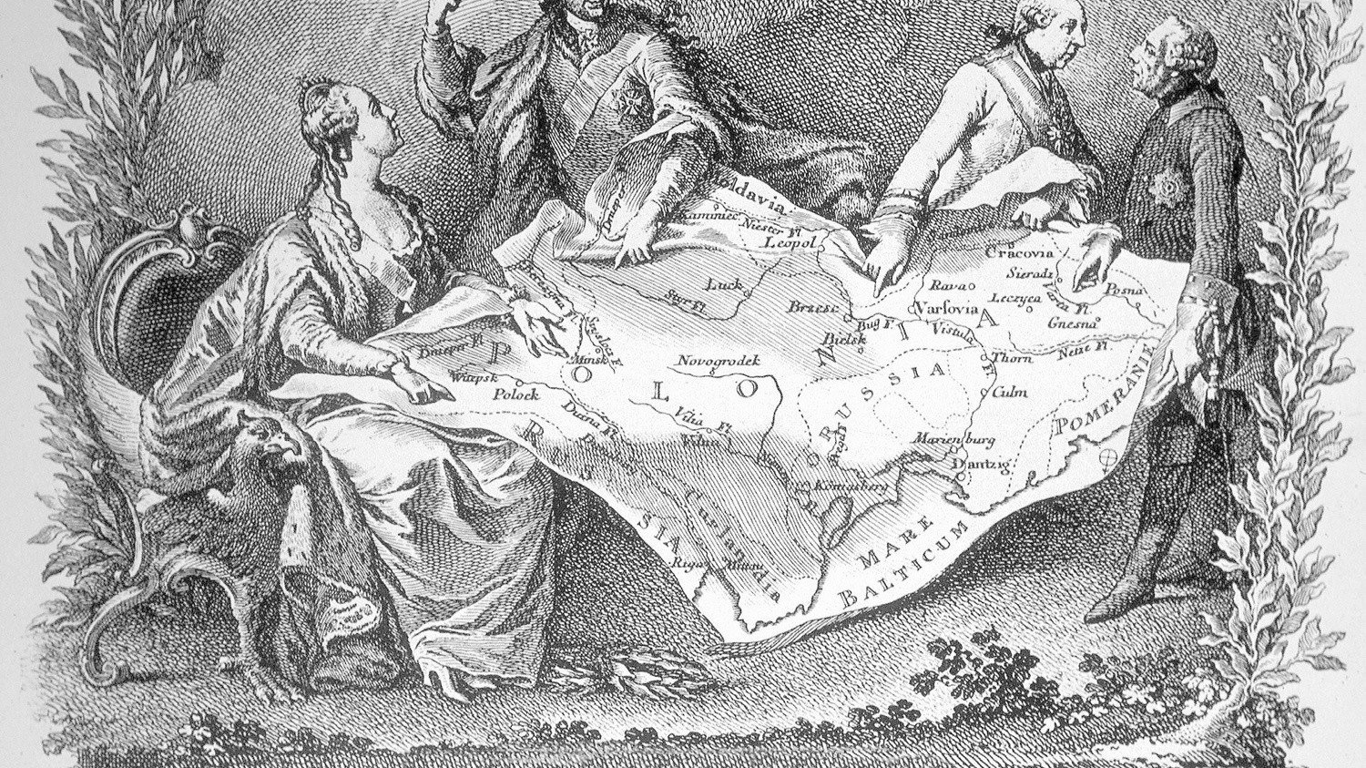
One hundred and twenty-three years of no contact
Further integration was interrupted by the partitions, as a result of which Poland's territories were fragmented and found themselves within the borders of three European powers - Austria, Prussia and Russia.

Slide 4
Attempts to return to old relationships
Despite various political initiatives, such as the functioning of the Lambert Hotel during the partitions, or the initiative to build a federation immediately after World War I, proposed by Józef Piłsudski, attempts to restore the dualistic state failed. For most of the interwar period, until 1938, when diplomatic relations were established, Poland and Lithuania were formally at war. Belonging to Vilnius and the so-called Central Lithuania, whose subordination to Poland was opposed by the government in Kaunas.

Slide 5
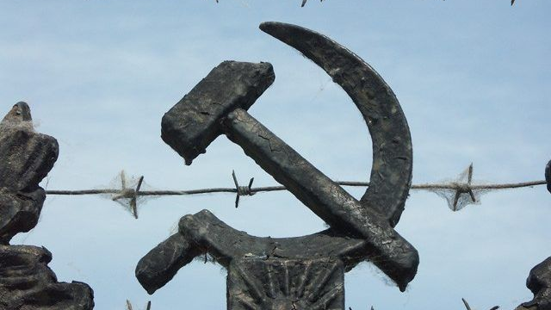
Behind the Iron Curtain
After the outbreak of World War II, these areas were transferred to Lithuania by the USSR (1939), but soon the entire territory of this republic was annexed by the Soviet Union. After the end of the war, both Poland and Lithuania, as the Lithuanian Soviet Socialist Republic, found themselves in the bloc of socialist states. In this situation, the issue of Polish-Lithuanian relations formally did not exist, and matters related to it were discussed only in emigration circles. The change was brought only by the collapse of the Eastern Bloc – including partially free elections in Poland in 1989 and regaining independence by Lithuania in 1991. Currently, both countries are trying to develop good neighborly cooperation.

Slide 6
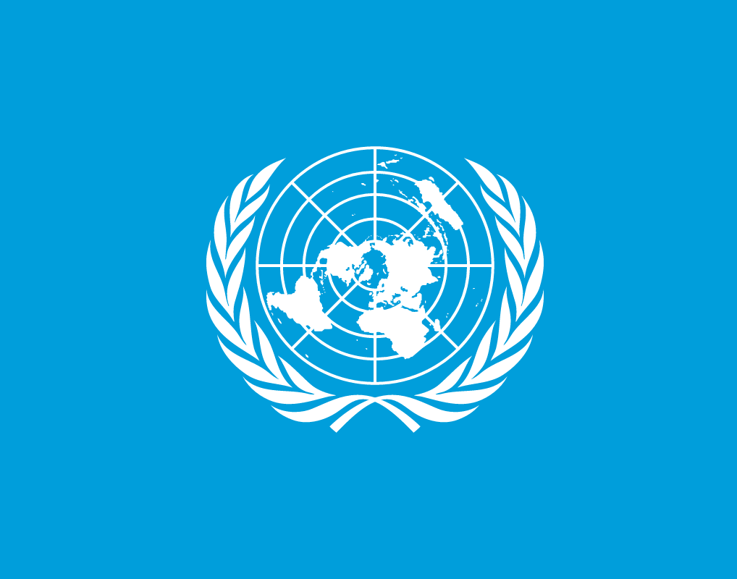
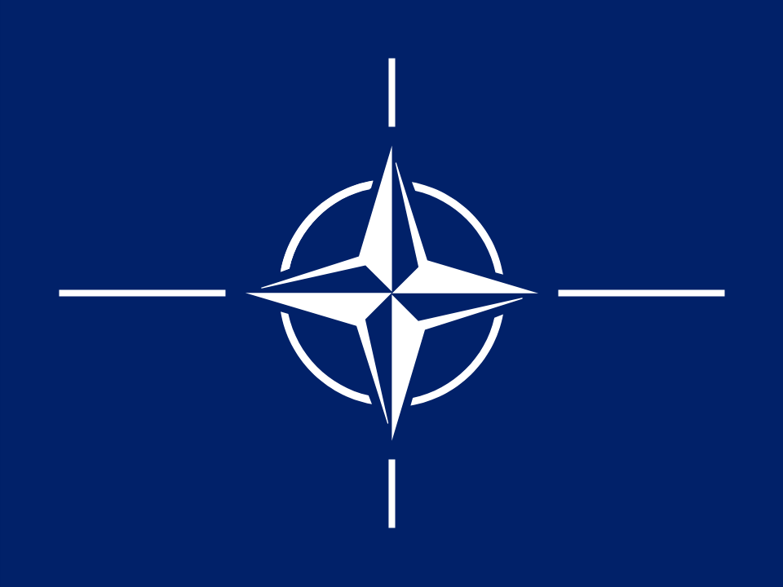
International organizations and alliances
Both countries belong to a huge number of international organizations, i.e., NATO or the UN, which allows for continuous military, as well as social and cultural support.

Slide 7
Thank you for your attention

Slide 8
Sources:
https://pl.wikipedia.org/wiki/Stosunki_polsko-litewskie

