Slide 1
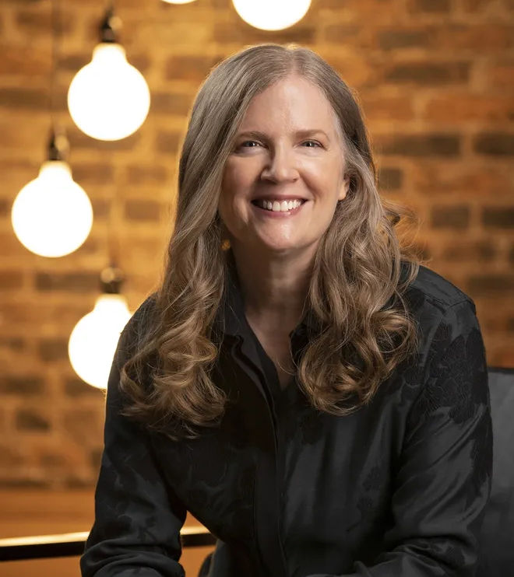
MY FAVOURITE WRITER
SUZANNE COLLINS
Presentation created by Milena Sadło

Slide 2
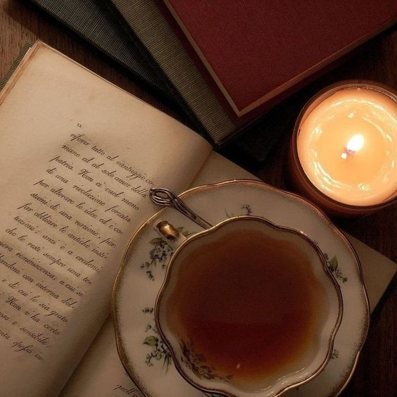
Who is Suzanne Collins?
Suzanne Collins was born on August 10, 1962, in Hartford, Connecticut. She is the youngest of four children, which include Kathryn, Andrew, and Joan. As the daughter of a military officer, she and her family were constantly moving. She spent her childhood in the eastern United States.
She is an American television writer and novelist. She is the author of the bestselling series The Underland Chronicles and the wildly successful Hunger Games trilogy, which spawned the Lionsgate film and subsequent announced sequels. After earning a degree from Indiana University with a double major in drama and telecommunications, Collins began her television writing career. She worked on a number of television productions for Nickelodeon such as Clarissa Explains It All, Little Bear and Oswald.

Slide 3
Nominations
She was nominated for a Writers Guild of America award for her work in co-writing Santa, Baby! A well-received animated Christmas special. Said to be inspired in part by ‘Alice in Wonderland,’ Collins' first book for middle schoolers, Gregor the Overlander, was nominated for a Nutmeg Children's Book Award. Between 2003 and 2007, Collins added four more titles to the New York Times bestselling Underland Chronicles series before turning her attention to Katniss Everdeen and The Hunger Games.

Slide 4
The Hunger Games description
In the ruins of a place once known as North America lies the nation of Panem, a shining Capitol surrounded by twelve outlying districts. The Capitol is harsh and cruel and keeps the districts in line by forcing them all to send one boy and one girl between the ages of twelve and eighteen to participate in the annual Hunger Games, a fight to the death on live TV. Sixteen-year-old Katniss Everdeen, who lives alone with her mother and younger sister, regards it as a death sentence when she steps forward to take her sister's place in the Games. But Katniss has been close to dead before—and survival, for her, is second nature. Without really meaning to, she becomes a contender. But if she is to win, she will have to start making choices that weight survival against humanity and life against love.

Slide 5
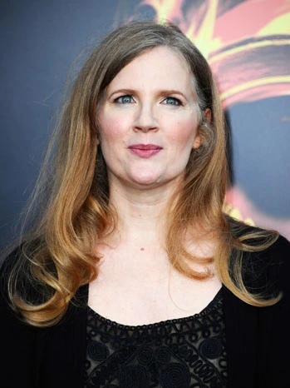
Why did I choose Suzanne Collins?
Suzanne Collins is a wonderful writer and I have loved her since reading the first volume of the hunger games trilogy. Her writing style is incredibly fascinating, and I fell in love with it from the very first page when I couldn't tear myself away from the book because it was so captivating. I think the whole trilogy and her other works are worth recommending.

Slide 6
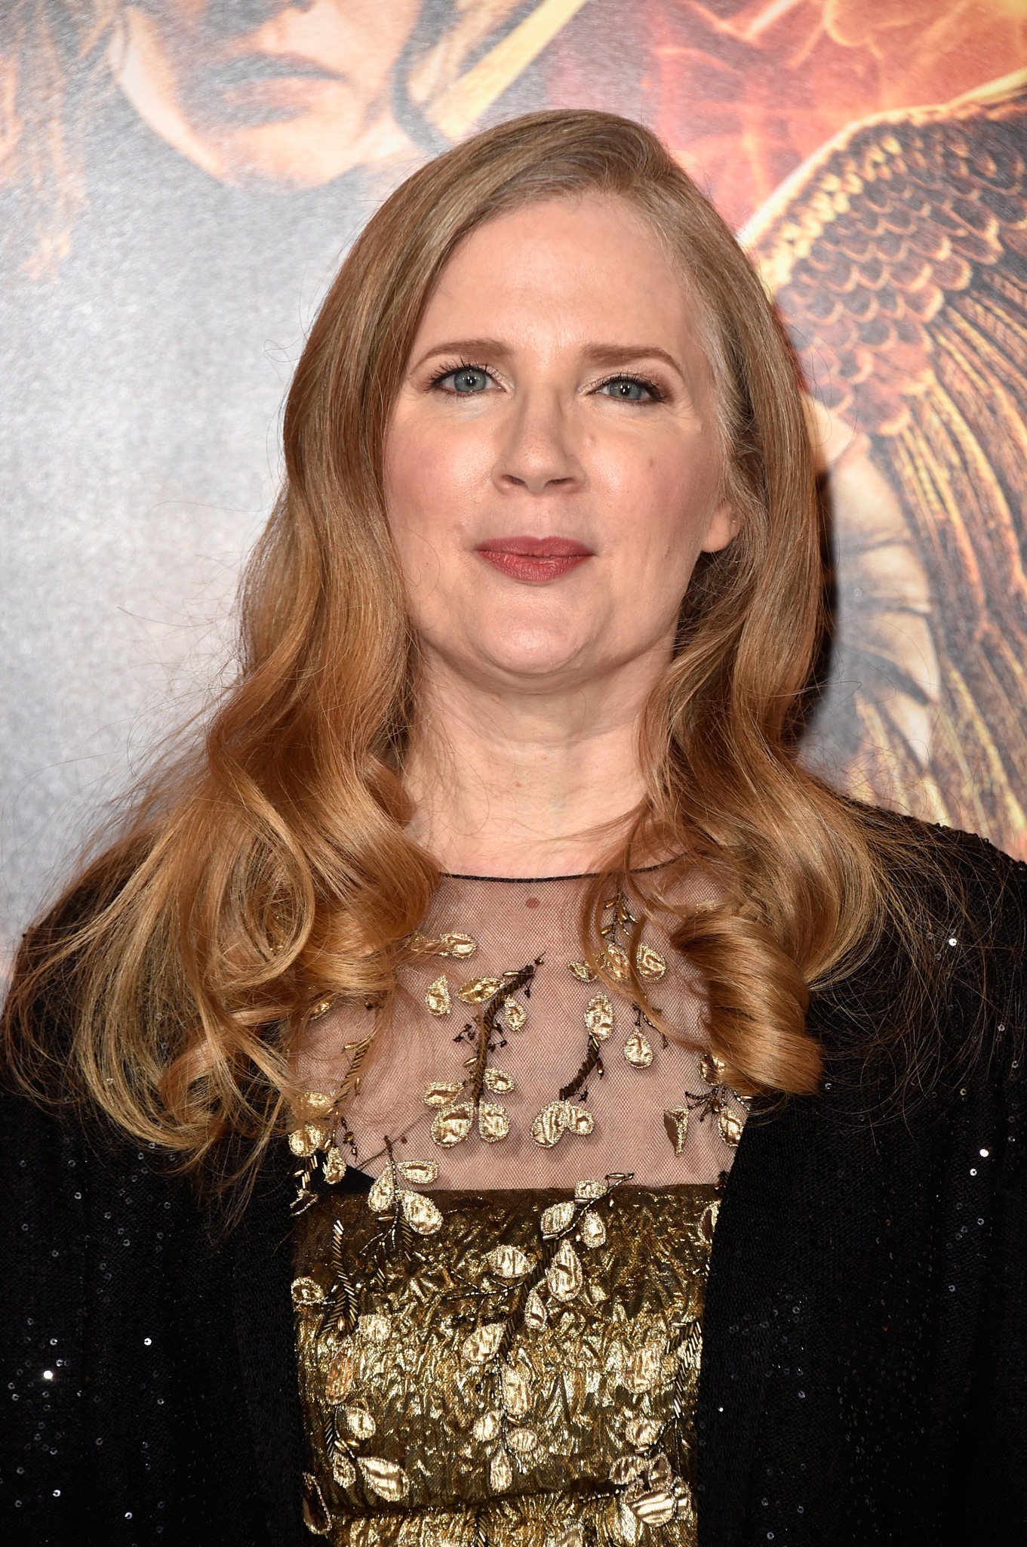
Thanks for your attention!

