Slide 1
POETESS
My favourite
Wisława Szymborska

Slide 2
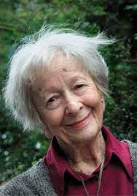
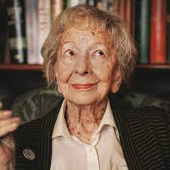
Some pictures of Wisława Szymborska

Slide 3
Wisława Szymborska was born 2 July 1923 and died 1 February 2012 in Cracow. She was a Polish poet, essayist, translator, and award winner of the 1996 Nobel Prize in Literature.

Slide 4
Interesting facts about Wisława Szymborska:
Apart from her, only two other Polish women won a Nobel Prize, and that was Maria Skłodowska-Curie and Olga Tokarczuk.
Wisława Szymborska published around 350 poems in 13 poetry books. Also, she transated a lot of French and German poems.
Her real first name was Maria, Wisława was her middle name.
She studied at the Jagiellonian Uniwersity in Cracow.
During the World War II, she worked at the railway station, that is the only reason she wasn’ t taken away to Labour Camp to Nazi Germany.
Her works were translated into 42 languages.

Slide 5
What Wisława Szymborska's poems are about
Her poetry is diverse and deals with different themes in each poem. Mainly, however, the poet asks questions about the order of the world, about the extent to which our lives are determined by chance, by coincidence or with themes of death and transience.
For example, in the poem „O śmierci bez przesady', the author portrays death as ruthless - the popular motif of the dance macabre expressed the belief that no one can free themselves from its power. Death is described as the most powerful ruler, ascribed omnipotence and might. Death's omnipotence evokes, above all, fear.

Slide 6
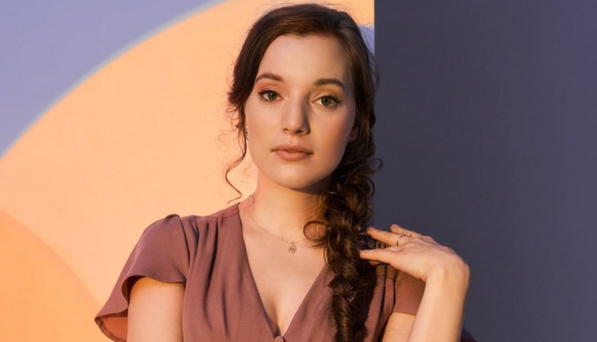
Wisława Szymborska’s works in the present day.
Many artists are inspired by Wisława Szymborska's works.
For example, the Polish singer Sanah, in her album "Sanah śpiewa poezje ", sang one of the Nobel Prize winner's best-known works, a poem entitled "Nic dwa razy„.
Another example of how Szymborska's poetry can be used today is a clothing collection inspired by her work, created thanks to a collaboration between the Medicine brand and the Wisława Szymborska Foundation. The 'Possibilities' collection is more than just clothes. It is first and foremost a project that illustrates how literature, fine art and fashion can correspond with each other and create surprising effects.

Slide 7
Wislawa Szymborska quotes I like best
„Either she loves him or she's stubborn. For better, for worse and for mercy.”
„A man who has not tasted his tears - is not a real man.”
„Reading books is the most beautiful pastime humanity has invented.”
„History rounds up skeletons to zero.”
„And whatever I do,
will forever turn into what I have done.”
„I am what I am. An inconceivable coincidence, like any coincidence.”
„I am disposable down to the marrow of my bones.”

Slide 8
THE END
Thank you for your attention!

