Slide 1
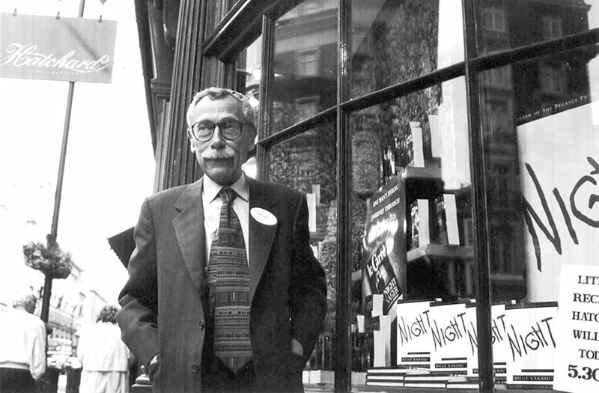
BİLGE KARASU

Slide 2
WHO IS BİLGE KARASU ?
He is a Turkish short story, novel and essay writer. KARASU, who is also a philosopher, spent part of his life as a translator. He is one of the important names of post-modern novelist in Turkey.

Slide 3
The Life Of Bilge KARASU
Bilge KARASU was born on January 9, 1930 in Istanbul. He started his education at Şişli Terakki High School and later studied at Istanbul University, Faculty of Literature, Department of Philosophy. In 1963, he went to Europe on a Rockefeller scholarship. He returned to Turkey in 1964 and started to work as a translator. He worked as a lecturer at Hacettepe University, Department of Philosophy from 1974 until his death. He faced difficult health problems. KARASU was treated for cancer. He died on 13 July 1995 at Hacettepe University Hospital, to which he devoted his life.

Slide 4
… And A Writter Is Born
Bilge KARASU, who started writing at the age of 17, wrote his first work in 1950. He wrote his first short story in 1952. The subject of his works is usually the psychology of the individuals. He used concepts such as "love", "friendship", "loneliness", "passion", "belief/disbelief", "fear" and "death". The reader finds parts of himself in his works. Their stories expand people the readers’ imaginations.

Slide 5
KARASU, one of the most original authors of Turkish literature, is the only Turkish author to win the "Pegasus Award" in America with his book "Night"; With this award, his books were translated into English and he gave lectures on new Turkish literature at various universities in the USA. His last book "Six Months and One Autumn« was published in 1996 after his death.

Slide 6
Short Stories
Troya'da Ölüm Vardı (Death In Troy)
Uzun Sürmüş Bir Günün Akşamı (The Evening Of A Long Day)
Göçmüş Kediler Bahçesi (The Garden Of Migrated Cats)
Kısmet Büfesi (Destiny Kios)
Lağımlaranası ya da Beyoğlu
Susanlar (The Silents)

Slide 7
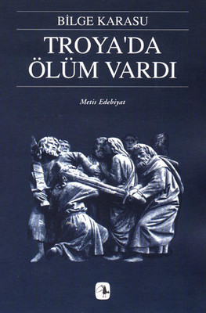
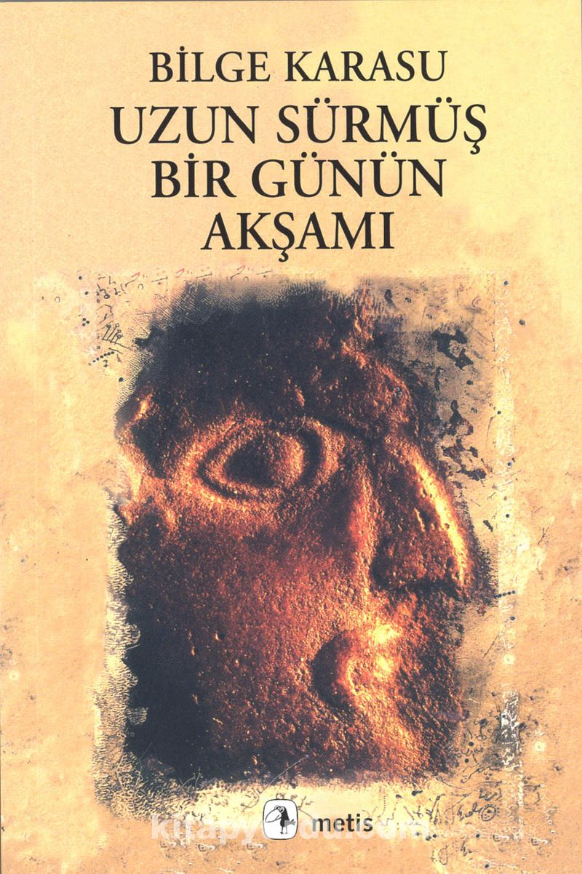

Slide 8
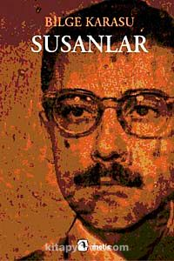
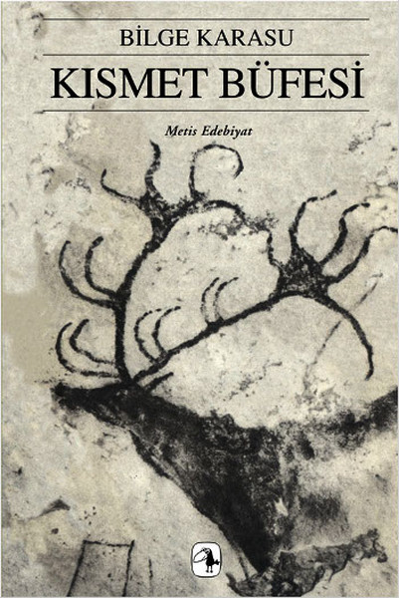

Slide 9
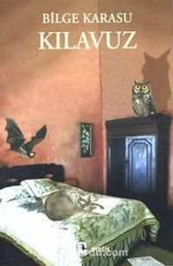
Novels
Gece (Night) Pegasus Award-winning novel
Klavuz (The Guide)

Slide 10
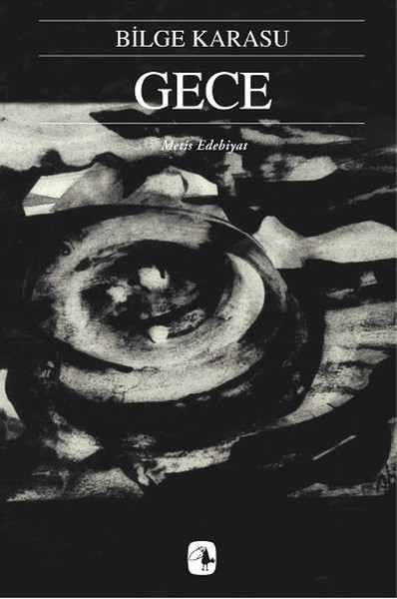
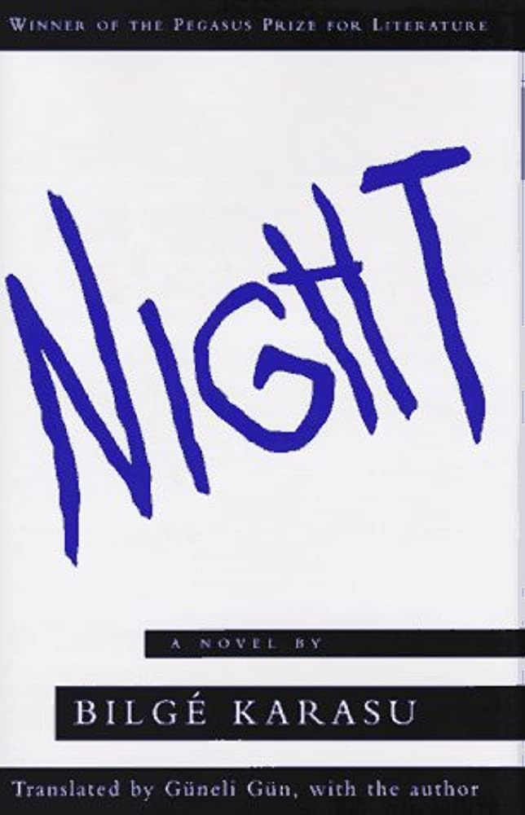
GECE (NIGHT)
Bilge KARASU's novel about "good and evil" attracted a lot of attention. In this way, he received the "Pegasus Award" given in America. He is the only person in Turkey to receive this award.

Slide 11
This novel was published in 1985.
Workers of the Night: These workers are individuals who emerge from the darkness and night and symbolize the criminals who want to cause turmoil.
Editor: He is an intellectual writer. It is the symbol of the individual left alone, separate from the people who create chaos in societies.
İt.: He is the person who takes part in the organization called "Sun Movement" to kill, slander and cause chaos. In the novel, the place and time of which are unknown, a dark environment in turmoil is symbolized by the concept of night.

Slide 12
The Content
“Workers of the night” are people who want the night to come as soon as possible. The men of the night will take advantage of the darkness to cause chaos as soon as evening comes. The workers of the night are the workers of the dark forces that prepare the environment for turmoil. These people have similar goals and characters in many ways also common destinies.

Slide 13
The side against these people is the Corrector. The Corrector is a thoughtful writer who feels alone in the face of turmoil. stands alone against the laborers of the spreading night. In this night he lives alone, he is in a passive war. He is worried about losing this light, which he lived at the summit, to the workers of the night.

Slide 14
This structure, which also uses night workers in its works, creates a great deception by calling itself the "Solar Movement" and promoting the sun and light; They want to lead humanity into darkness and night. The structure, which seems to defend the opposite of what it wants, kills people to achieve its goals. This structure is an organization that tries to achieve its goals by threatening and killing people.

Slide 15
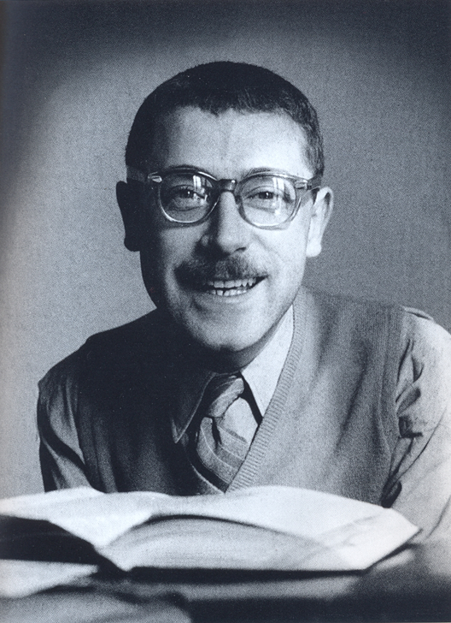
We loved the book, I hope you will read it too ☺
Thank you for listening ♡
Turkish Erasmus Group

