Slide 1
Alessandro Manzoni

Slide 2
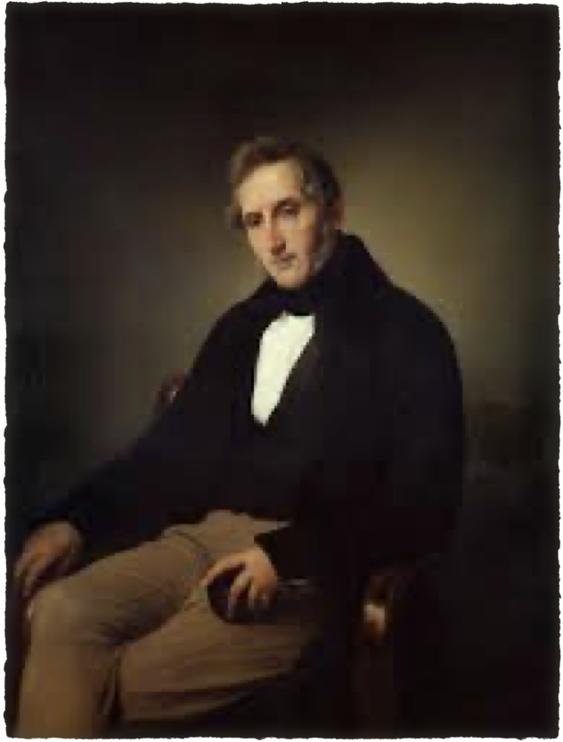
Alessandro Manzoni was an Italian poet, a novelist and a playwright born on March 7 1785 in Milan, Italy. He was born into a wealthy aristocratic family and his father was an influential politician and a writer. Manzoni grew up in a cultured environment and received excellent education, studying Latin, Greek, and French.

Slide 3
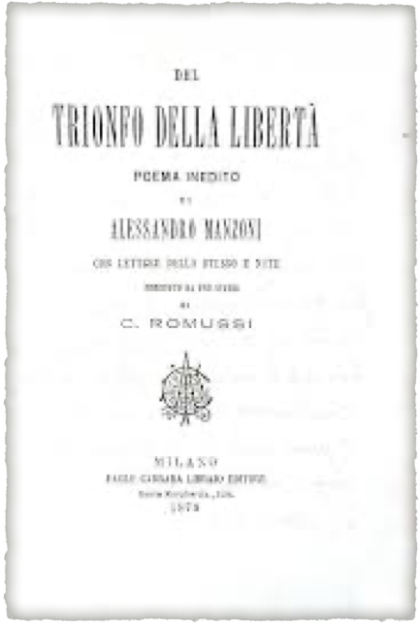
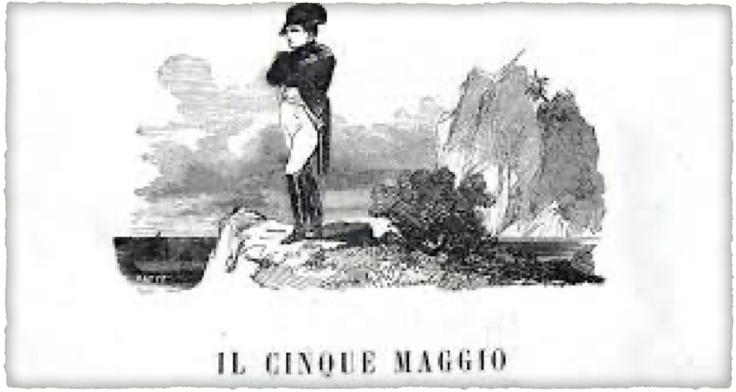
Manzoni's literary career began in 1801, with the publication of his first poem, "Il Trionfo della Libertà" (The Triumph of Liberty). He went on to write several other poems, including "Il Cinque Maggio" (The Fifth of May), which commemorates the death of Napoleon Bonaparte.

Slide 4
In 1821, Manzoni began work on his most famous novel, "I Promessi Sposi" (The Betrothed), which was published in 1827. The novel tells the story of two young lovers, Renzo and Lucia, who are separated by a cruel and corrupt society. The novel is considered a masterpiece of Italian literature and has been translated into many languages.

Slide 5
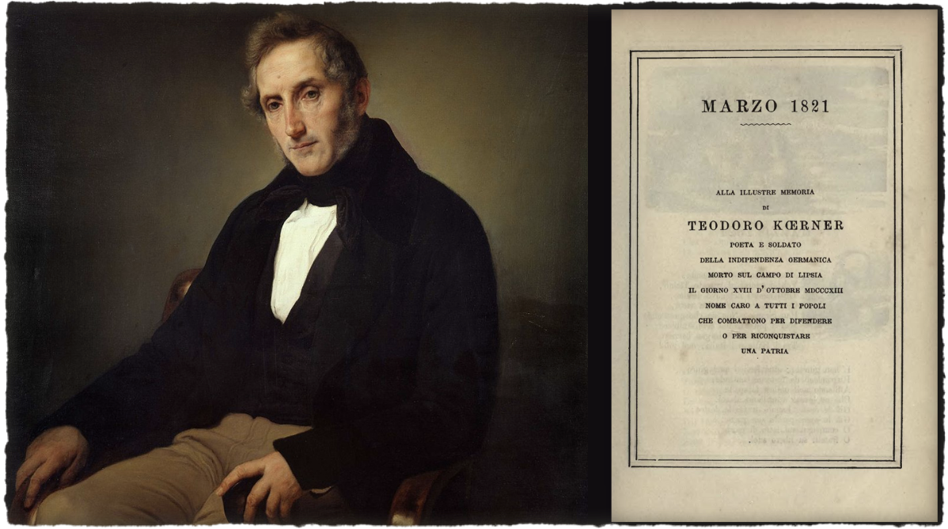
Manzoni was also involved in politics and was a supporter of Italian unification. He was a member of the Carbonari, a secret society that advocated Italian independence from foreign powers. Manzoni's political views are reflected in his works, which often deal with themes of social justice and the struggle for freedom.

Slide 6
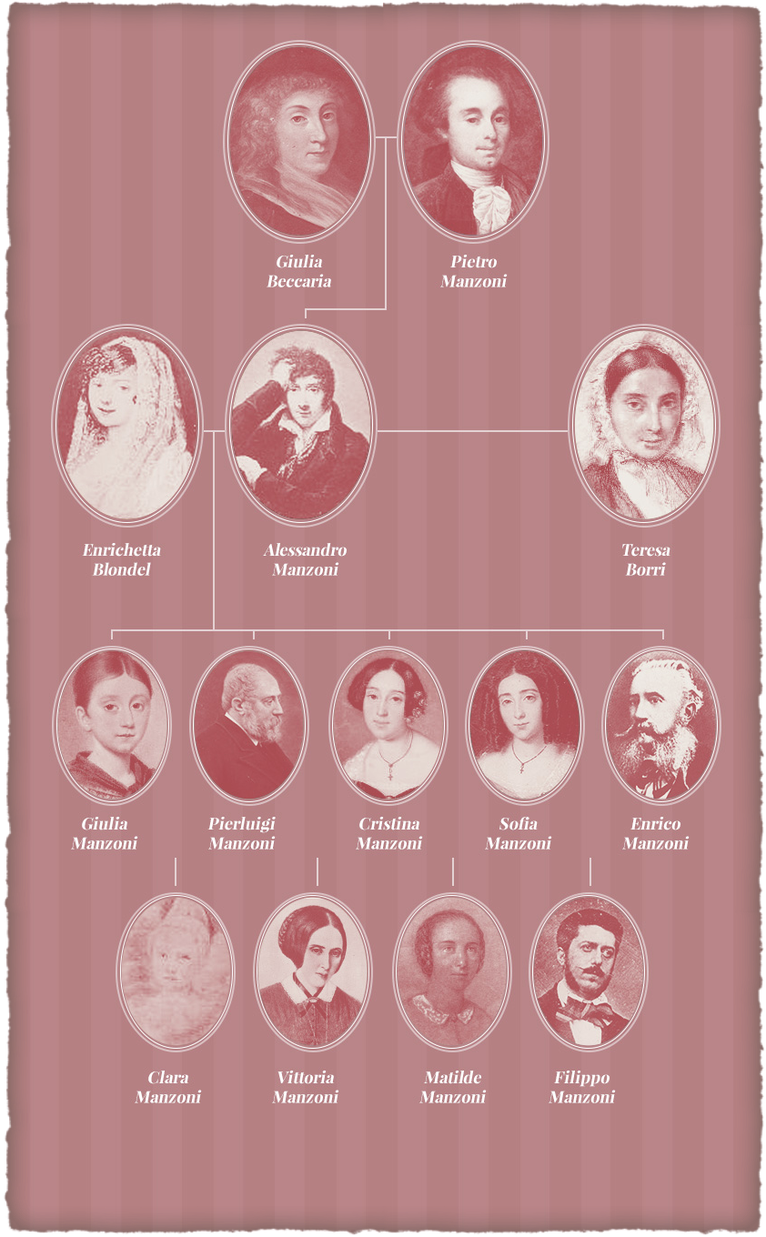
In addition to his literary and political activities, Manzoni was also a devoted husband and a father. He married Teresa Borri in 1808 and they had nine children. Manzoni died on May 22 1873 in Milan, Italy, at the age of 88. His legacy as one of Italy's greatest writers and cultural icons continues to this day.

Slide 7
‘I Promessi Sposi' (The Betrothed) is a work written by Alessandro Manzoni and released for the first time in 1827 and it’s composed of 38 chapters.

Slide 8
Don Abbondio and the Bravi
The story begins with Don Abbondio, a priest chosen to celebrate the marriage between two young people in love, Renzo Tramaglino and Lucia Mondella. While walking, he is stopped by the Bravi, two thugs at the service of a local lord, Don Rodrigo, who ask the priest not to celebrate the wedding. In fact, their lord has made a bet with his cousin, with Lucia as a prize. Don Abbondio complies and makes excuses not to marry them, but Renzo learns the truth.

Slide 9
Azzeccagarbugli and Fra Cristoforo
Lucia’s mother, Agnese, proposes to contact Azzeccagarbugli, a lawyer who is initially ready to help the young man, but after discovering Don Rodrigo‘s involvement , he sends Renzo away.
The two young lovers contact Fra Cristoforo, a defender of the humble, to help them. Fra Cristoforo goes to Don Rodrigo’s house to convince him to renounce his plans, even threatening him with Divine Punishment, but he still refuses.

Slide 10
The surprise wedding and the escape
Agnese suggests a surprise marriage, but the plan fails because of Don Abbondio. Meanwhile Don Rodrigo sends the bravi to kidnap Lucia; fortunately, she’s not in the house and the young couple decide to leave for Milan and Monza with Fra Cristoforo‘s help. Lucia is taken to a Monza convent and Renzo remains trapped in the middle of a popular uprising in Milan , caused by the high cost of bread. Risking to be arrested, Renzo manages to hide in his cousin’s house in Bergamo, while Fra Cristoforo is transferred to Rimini.

Slide 11
L’Innominato and Lucia’s kidnapping
Don Rodrigo, after finding out Lucia’s location, asks for Innominato’s help to kidnap Lucia. The young woman pleads with the powerful lord to be freed and makes a chastity promise to the Virgin Mary. Unexpectedly, Innominato repents, sets Lucia free and even gives her a dowry.

Slide 12
Reunion and Conclusion
After several months the plague arrives in Lombardy and causes many deaths. Don Rodrigo also dies of the plague. Even Renzo is infected but he recovers and looks for Lucia in an isolation hospital for the diseased.
It is in the hospital where everybody meets in the end: Renzo, Lucia and Fra Cristoforo, who urges Renzo to renounce his desire for revenge.
Once back in their village, the young lovers finally get married by Don Abbondio. The two of them have a daughter, named Maria as a sign of gratitude to Our Lady, and later other children.

Slide 13
Themes:
greed: Don Rodrigo is a selfish man who wants Lucia as his mistress simply to win a bet. He's willing to go to great lengths to have her;
the benefits of innocence and humility: Lucia is saved by her innocent character and kindness. It makes people want to stand up for her and help her;
forgiveness: best exemplified by Fra Cristoforo, who once killed a man. He was wealthy, privileged, and gave it all up to repent for his sins. He's grown into a kind and saintly man who has a lot to offer to the world.

