Slide 1
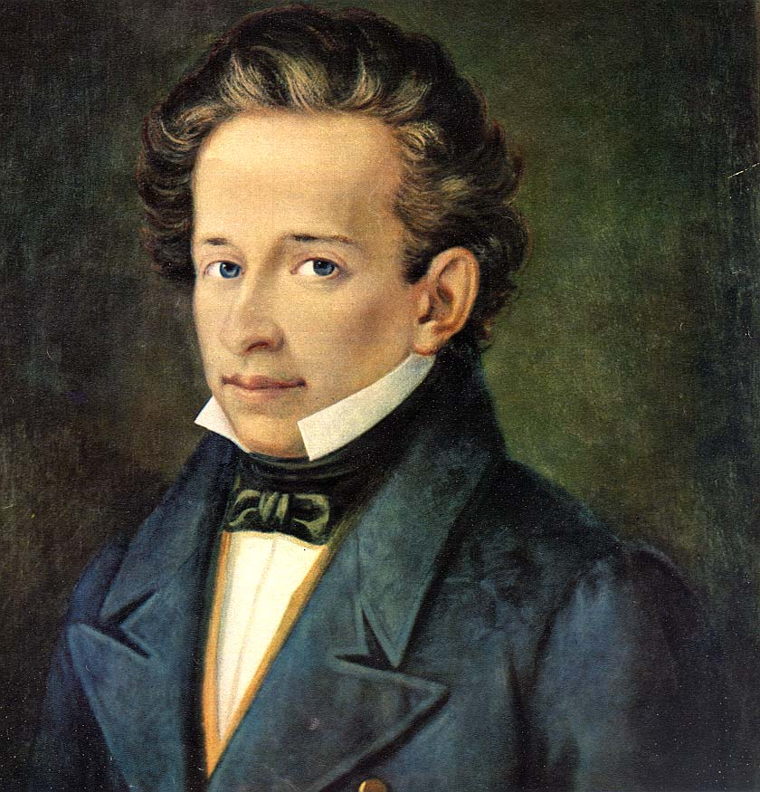
GIACOMO LEOPARDI AND L'INFINITO
Questa .
Anna Claudia Tricarico
Ylenia Trotta
Marta della Malva

Slide 2
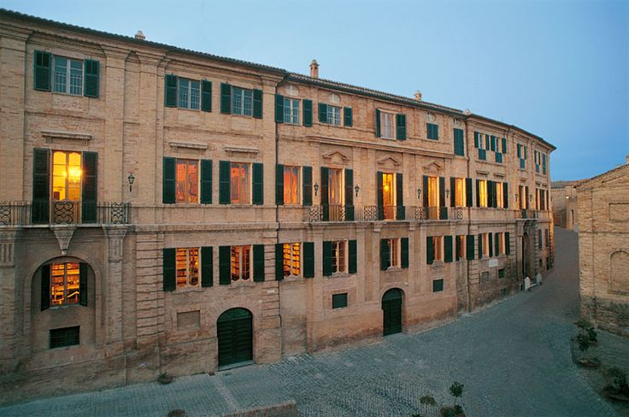
GIACOMO LEOPARDI'S LIFE
Giacomo Leopardi was born on June 29, 1798 in Recanati. He was the eldest son of Count Monaldo and Adelaide Antici. The family was noble but at the same time bigoted and conservative. He received classical training from Hellenistic tutors; around the age of ten he continued his studies on his own.

Slide 3
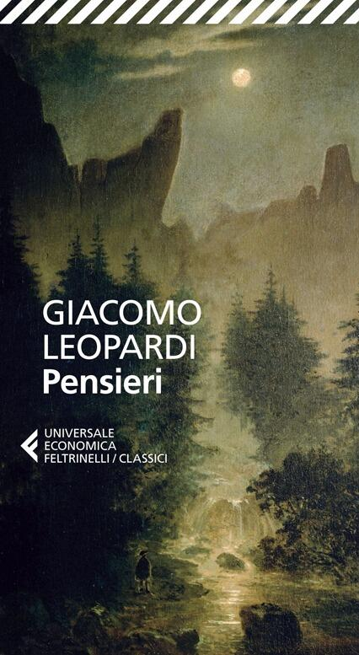
LEOPARDI'S THOUGHT
Leopardi's thought is best expressed in the Zibaldone: one of his most important works and an intellectual diary, composed between 1817 and 1832. The focus of this collection is a reflection on the unhappiness of man, who identifies happiness in material goods and aspires to infinite pleasure, but none of these can satisfy his need. From this lack of fulfilment comes his unhappiness.

Slide 4
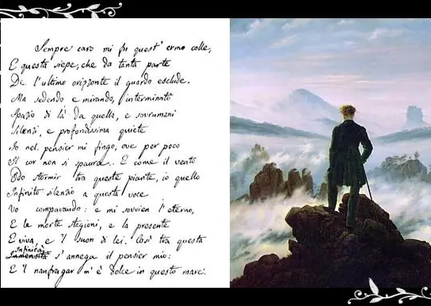
L'INFINITO
Another very important work by the poet is Infinity. It is the first of Leopardian Idylls, or six poems that would later be introduced in its most famous poetic collection 'I Canti' of 1831. The Infinite was composed in Recanati in 1819 and is a perfect example of Leopardi's thoughts.

Slide 5
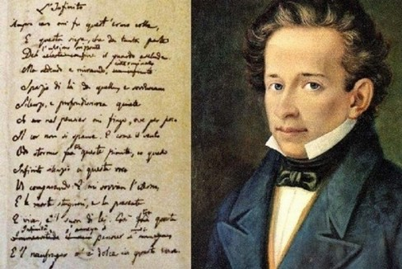
It is a sonnet divided in two parts: the first is spatial infinity, which begins with the impossibility of vision; the other - temporal infinity, or the auditory sensation.

Slide 6
THE THEME
The main theme is the poet's understanding of infinity. He argues that some vague and indefinite sensory experiences stimulate imagination that creates infinity, but the latter is unattainable for man from the point of view of pleasure. The experience of infinity is neither the search nor the revelation of a superior being but it is an illusion with which men seek comfort from pain.

