Slide 1
Coraline
By Neil Gaiman

Slide 2
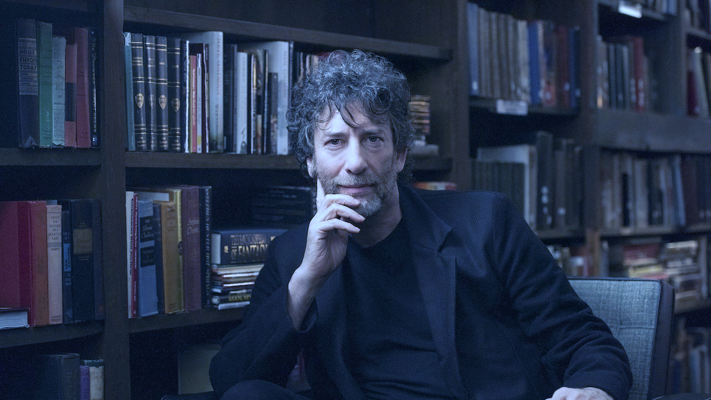
Neil Richard MacKinnon Gaiman
Born in 1960 november 10
English author

Slide 3
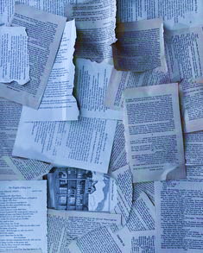
"Caroline"
Gaiman started writing Coraline in 1990
The titular character's name came from a typo in "Caroline"

Slide 4
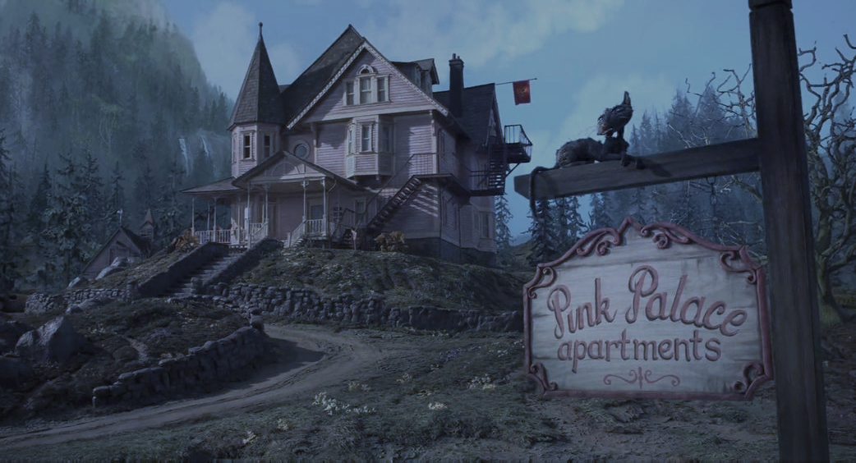
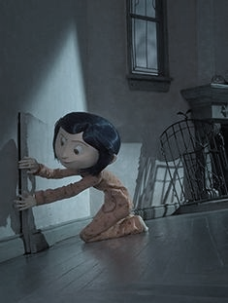
Short story
She feels bored and neglected by her parents. She plays an expoler to find a „new home”
Strong themes in this story: home, stand up for yourself

Slide 5
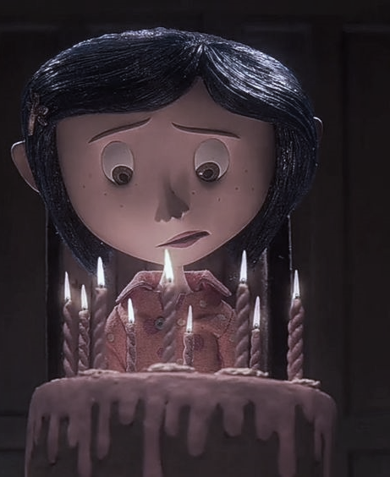
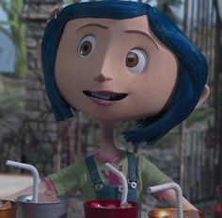
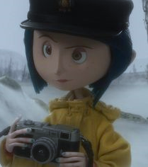
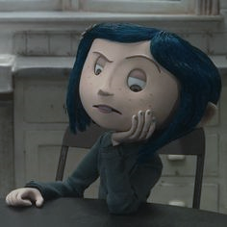
Coraline
11 year old main character
young explorer
intelligent, resourceful, and courageous
not being taken seriously by the olders

Slide 6
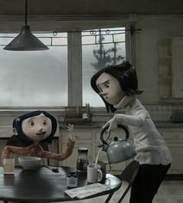
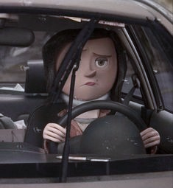
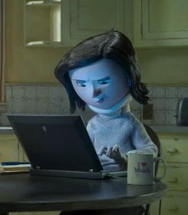
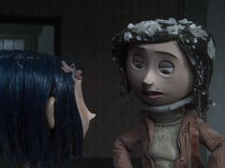
Mrs Jones
Coraline's mother
very busy
nice, and helpful

Slide 7
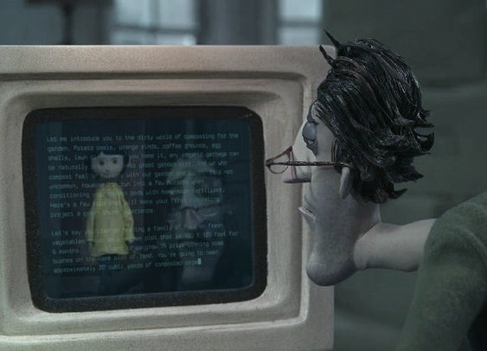
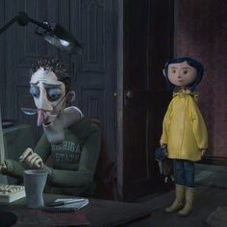
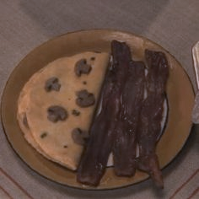
Mr Jones
Coraline's father
caring, kind, brave, and helpful
very busy
makes "creative" food creations

Slide 8
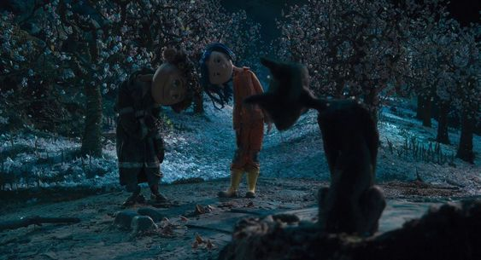
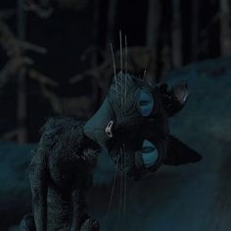
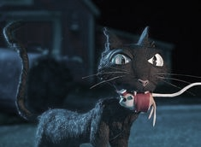
The cat
from the real world
acts as a mentor
unnamed

Slide 9
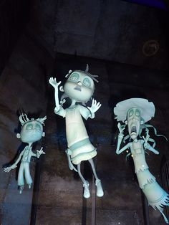
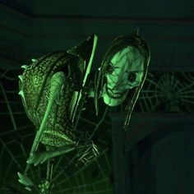
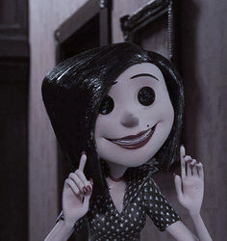
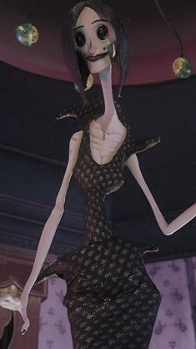
The Beldan
Other Mother
evil inhuman witch
ruler of the Other World

Slide 10
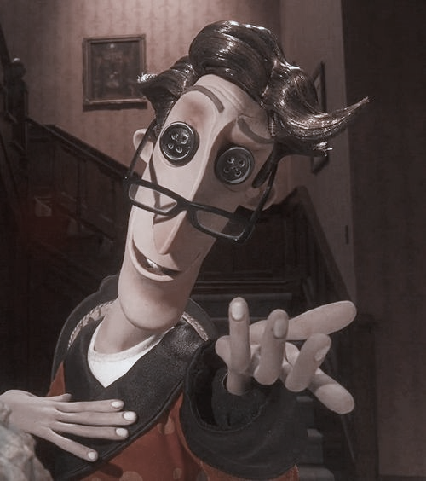
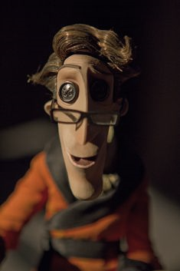
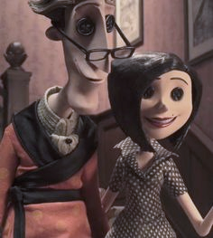
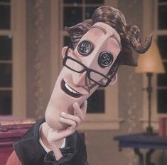
The Other Father
creation of the Beldam in the image of Mr. Jones
help Colarine to escape
similar like the real father

Slide 11
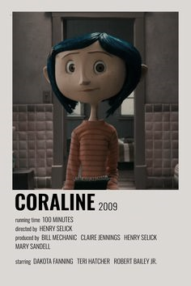
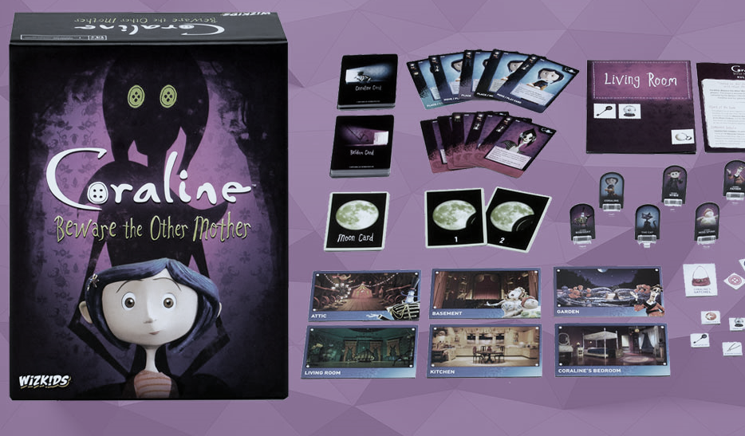
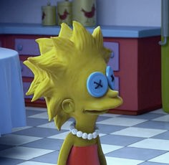
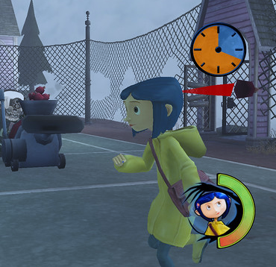
From the book they made
Movie
Use in the Simpson
Comic book
Video game
Operatics
Stop motion animated film

Slide 12
Thank you for the attention.
https://hu.pinterest.com
https://hu.wikipedia.org/wiki/Coraline_és_a_titkos_ajtó
https://hu.wikipedia.org/wiki/Neil_Gaiman
Made by Renata Kis

