Slide 1
Charles Dickens: A Christmas Carol

Slide 2
A Christmas Carol​
Charles Dickens (7 February 1812 – 9 June 1870)

Slide 3
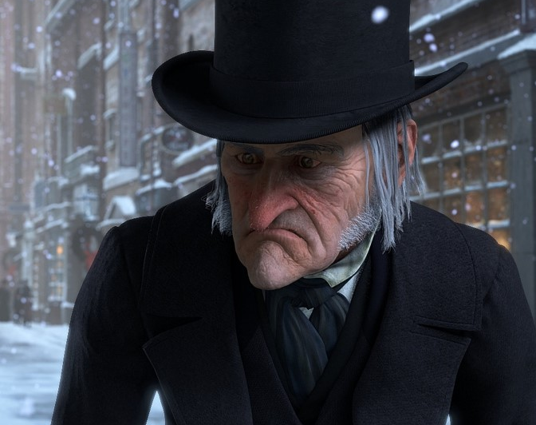
A Christmas Carol
Ebenezer Scrooge

Slide 4
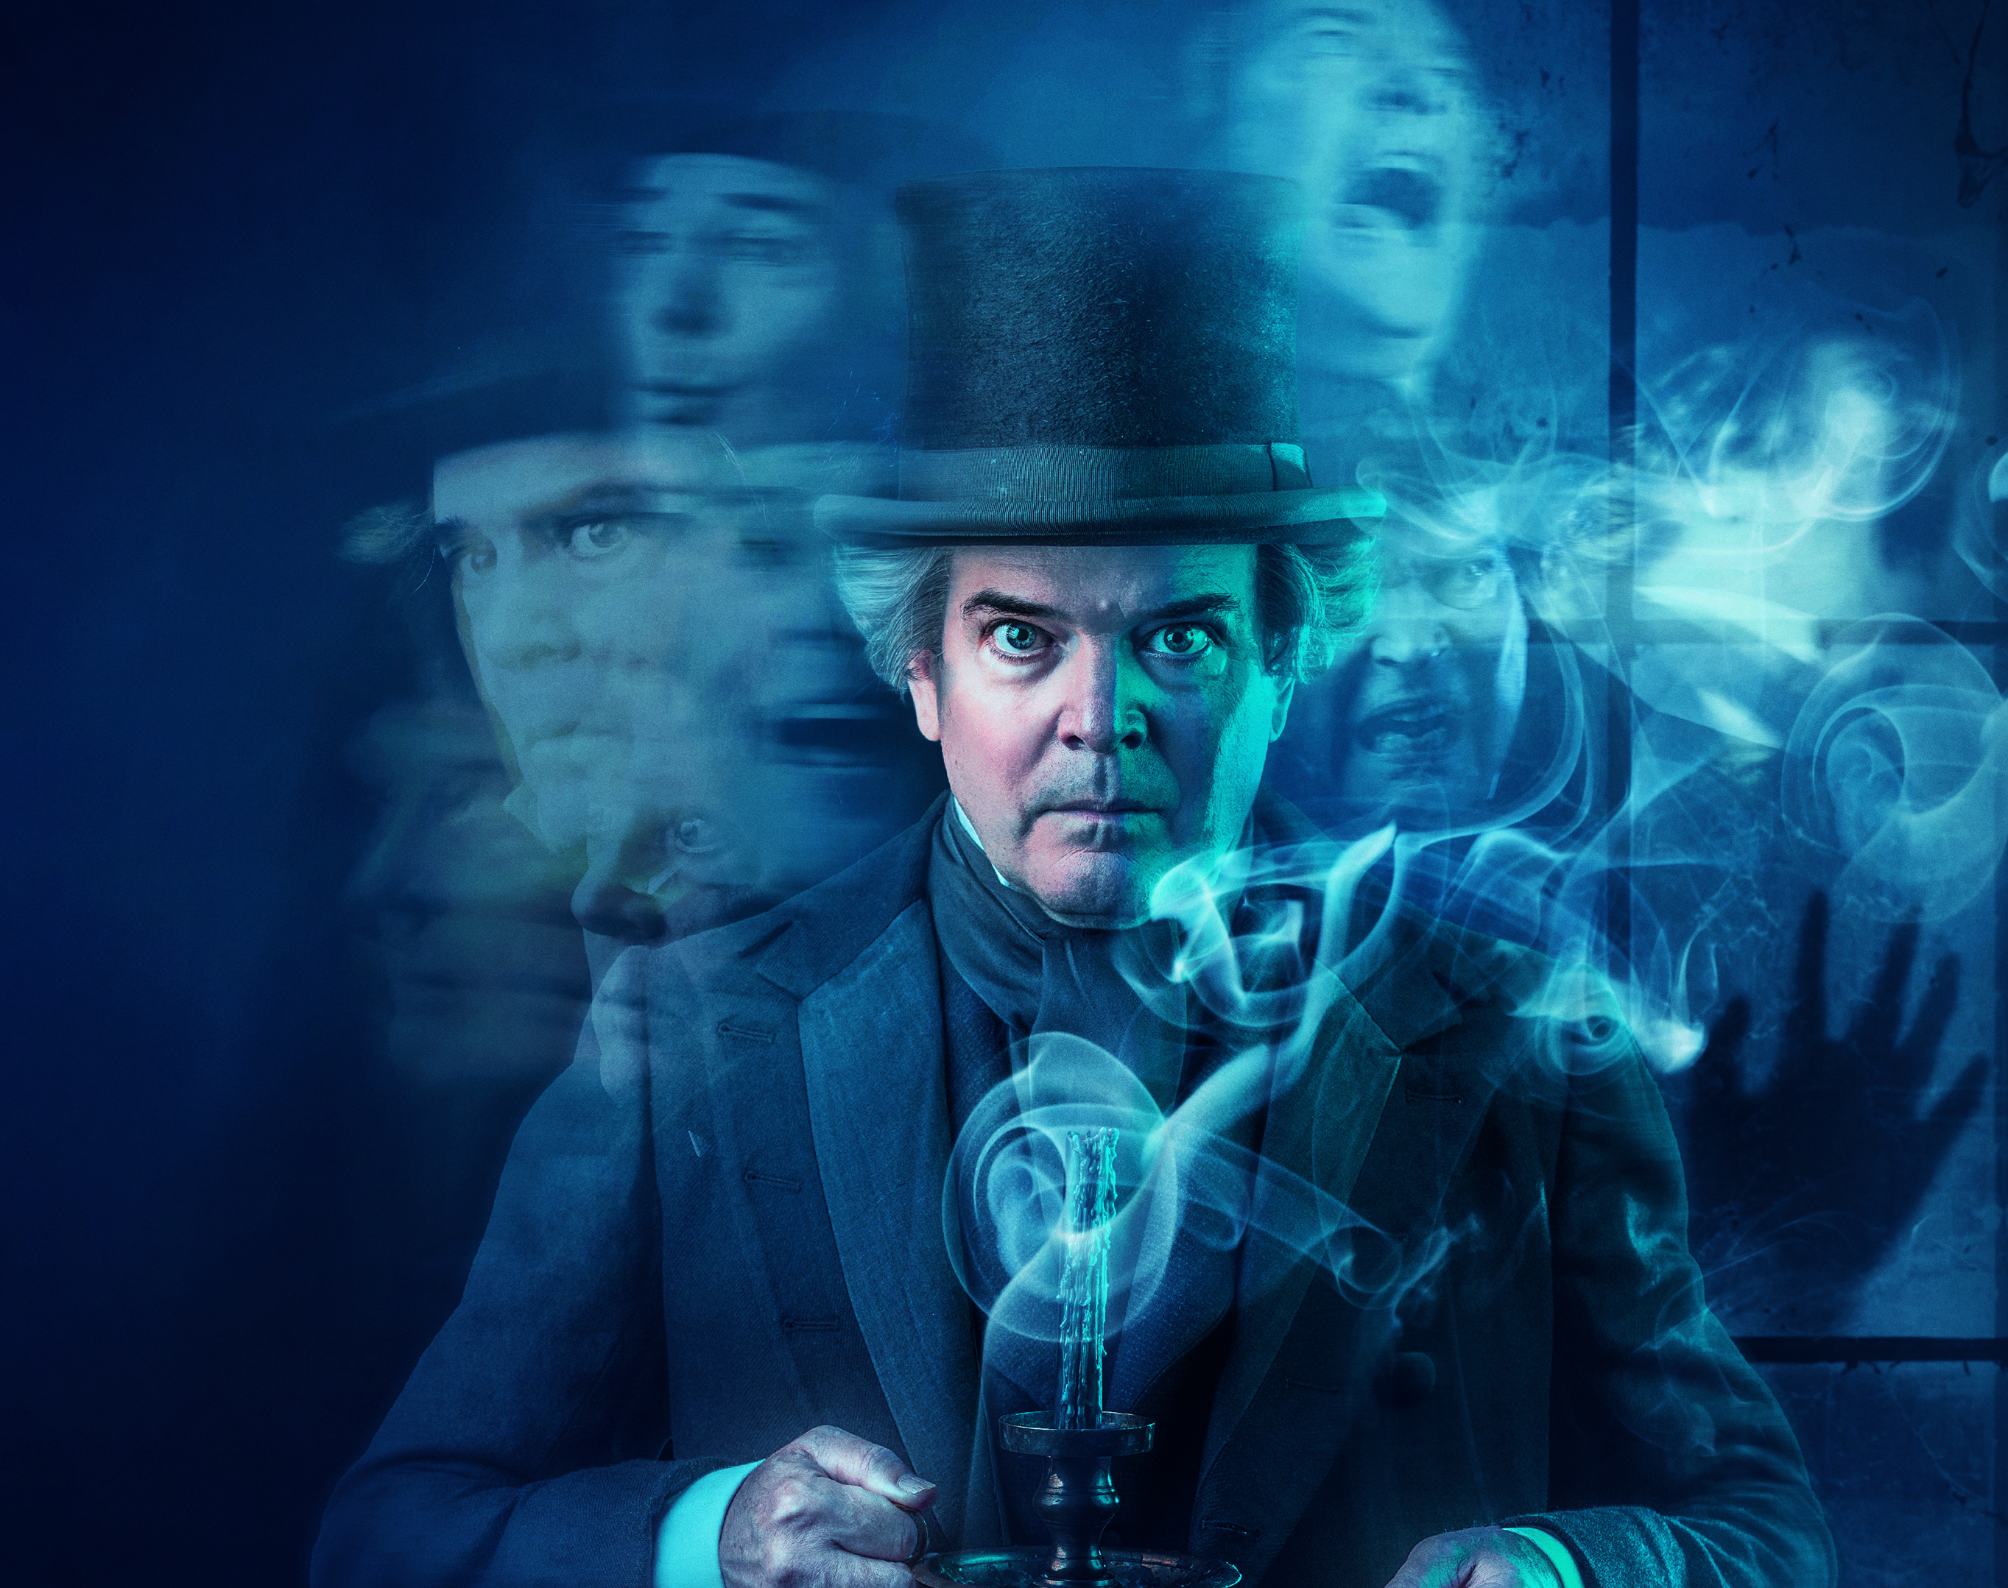
A Christmas Carol
The beginning of the novel

Slide 5
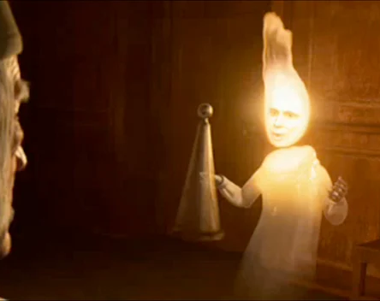
A Christmas Carol
The first night, The ghost of past Christmases

Slide 6
A Christmas Carol
The second night, the ghost of the present Christmas

Slide 7
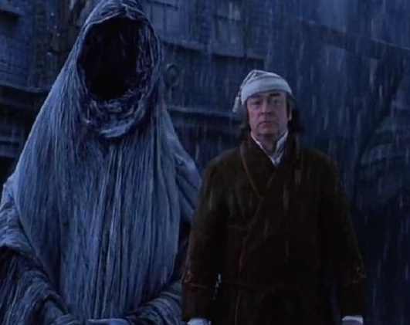
A Christmas Carol
The third night, the ghost of Christmases to come

Slide 8
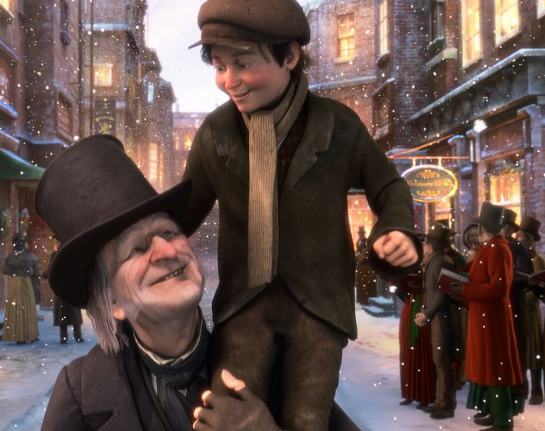
A Christmas Carol
The end of the novel

Slide 9
A Christmas Carol
Film adaptations

