Slide 1
Romeo and Juliet
William Shakespeare

Slide 2
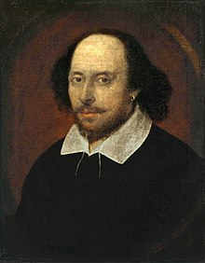
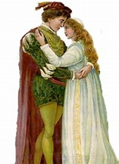
Romeo and Julia
Romeo and Julia is my favorite drama, one of the best known tragedies of the English playwright William Shakespeare.
It is about a fatal love between the children of two hostile families.
Not known exactly when he wrote it, but he mentions an earthquake in the work which is happened 11 years ago so it can be dated to 1591.
The lowers were separated due to family dispute, they couldn’t meet so their love could not really be fulfilled and because of this complication their love became fatal.

Slide 3
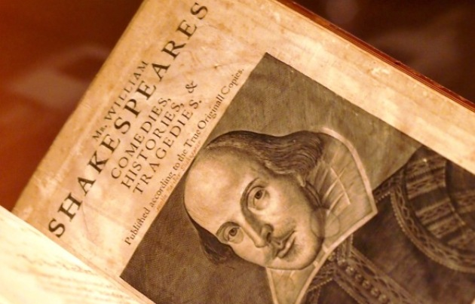
William Shakespeare
He was born on April 23, 1564.
He got married at the age of 18 and had 3 children
-During his life he did everything to become an actor and later a playwright
-Death: 1616, pneumonia in Stratford
-Probably he was a wealthy man, he tried to give his family what they needed
-He was one of the greatest man of English drama and European literature

Slide 4
R&J
The action takes place over five days, in different locations and even outside of Verona in Mantua.
Names of two families is Capulet and Montague.
At the very beggining in Verona the servants of two families fight each other with words in the main square.
After that Romeo and Benvolio hear that there will be in a ball in the Capulet house and his love will be there, who is called Rosalia.
Romeo is afraid to enter the ball because of the conflict, but he has to see his love. He suddenly forget Rosalia when see Julia.
Romeo and Juliet were aware that each other’s enemies so she ask Romeo to deny his name for love. The famous balcony scene comes into. Romeo swears his love and Juliet believes in him she worried for his life because Tybalt (who is belonge Capulet famil) challenged him to a dule.

Slide 5
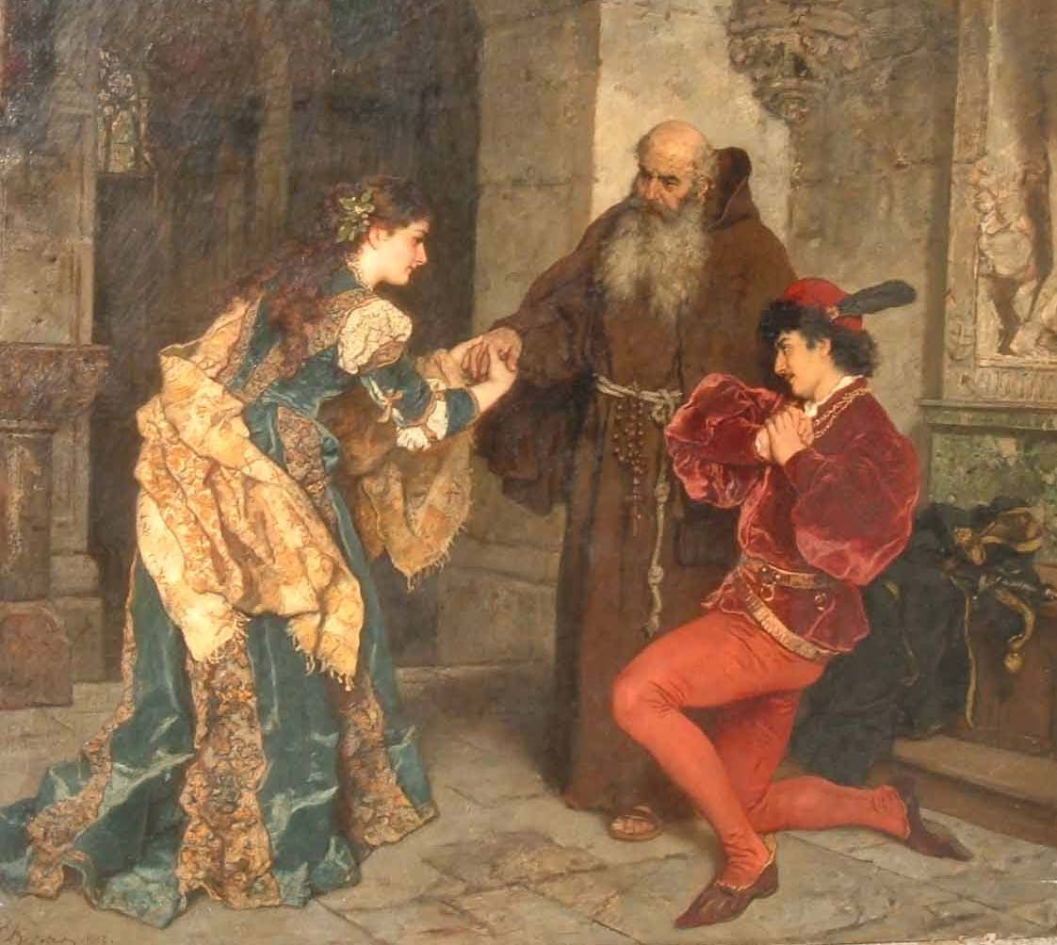
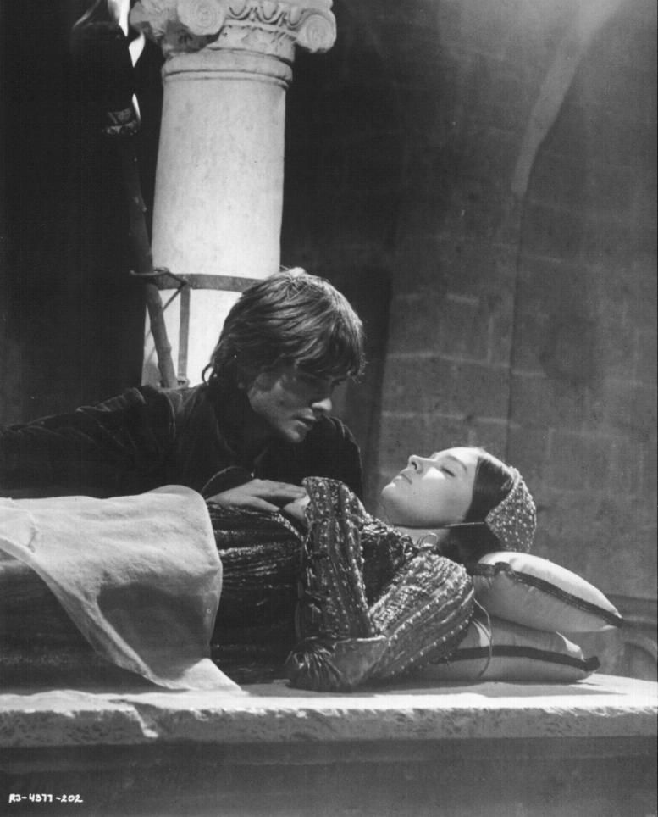
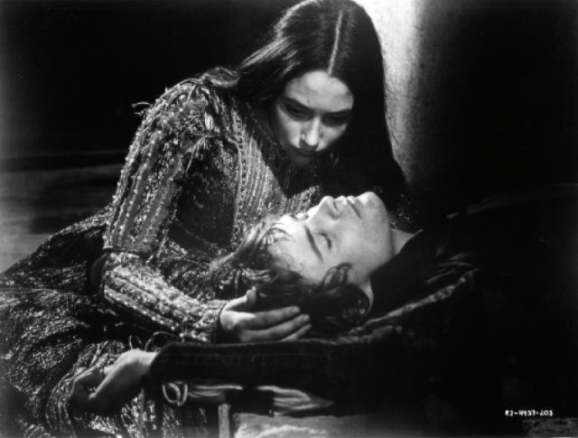
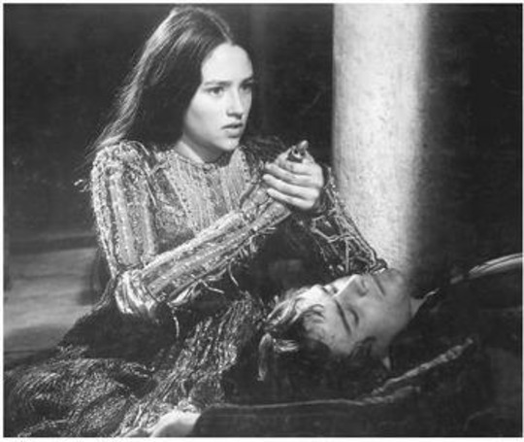
R&J
During the fight Romeo slapped Tybalt and he regretted because he know the Capulet family would not looking kindly on him
Juliet hear the news from her nanny and react alarmed that what is happened. Romeo and Juliet hear the sentence from the nanny and the priest, but the two adults not leave without action.
Romeo had to say goodbye from Juliet and start to run away. After that Julia’s parents let us know that they were promised her to Paris(who asked for the girl hand in marriage at the beggining of the year).
Romeo and Juliet’s friends: nanny and Lőrincz priest tries to avoid marriage with Paris. Thay had a plan what makes possible the marriage with Romeo.
The end is not to beautiful because the couple Romeo and Julia died because the parents enmity.

Slide 6
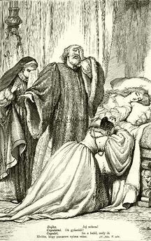
The parents

