Slide 1
My Favorite Writers

Slide 2
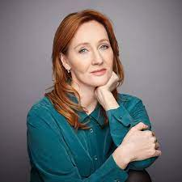
J. K. Rowling
J. K. Rowling, is a British author who wrote a seven-volume children's fantasy series, Harry Potter, published from 1997 to 2007. The series has been enormously successful and has sold over 500 million copies, been translated into at least 70 languages, and spawned a global media franchise including films and video games.

Slide 3
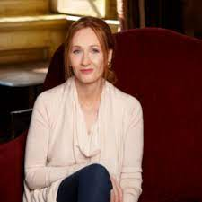
J. K. Rowling
I admire J. K. Rowling for her creativity. She impressed me with her imagination when I read her book for the first time because plot in her books ais amazing and fantastic. In my view she is one of the best writers in the world.

Slide 4
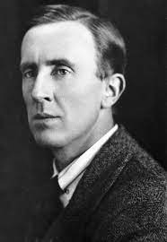
John Ronald Reuel Tolkien
John Ronald Reuel Tolkien was an English writer, poet, philologist, and academic, best known as the author of the high fantasy works The Hobbit and The Lord of the Rings. After Tolkien's death, his son Christopher published a series of works based on his father's notes . These, together with The Hobbit and The Lord of the Rings, form a connected body of tales, poems, fictional histories, invented languages, and literary essays about a fantasy world called Arda and, within it, Middle-earth. Between 1951 and 1955, Tolkien applied the term legendarium to the larger part of these writings

Slide 5
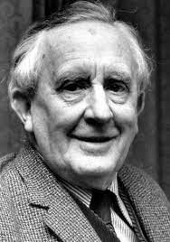
John Ronald Reuel Tolkien
I realy like the work of Tolkien because one my favourite type of books are fantasy and he is the best fantasy writer. Also his creativity is amazing I love his books and I can read them all the time

Slide 6
THANK YOU FOR ATTENTION

