Slide 1
SIVAS LISESI 2021-2022 ACADEMIC YEAR BOOK READING ACTIVITIES

Slide 2
As Sivas High School, various reading activities and reading competitions are planned for our students to improve their vocabulary, to enable them to express themselves better and to think practically, to strengthen their decision-making mechanisms and memories, and to increase their general culture.

Slide 3
In this context, our first event is the "Safahat Reading Contest", based on the poetry book "Safahat" by Mehmet Akif ERSOY, who is also the author of our "National Anthem", on the 100th anniversary of the adoption of the National Anthem.

Slide 4
With this competition, our students had the opportunity to enrich their vocabulary as well as get to know Mehmet Akif Ersoy's life and poems. Various awards were given to the students who ranked in the exam held on March 5, 2021, and it is planned to increase the interest in reading.

Slide 5
Another reading activity is the "Secrets of Turkish - a Book Reading Contest" by Nihad Sami Banarlı, held on the occasion of the "Year of Yunus Emre and Turkish". With this competition, it is planned to give our students the awareness that the rootedness of Turkish, the language of a nation that has established civilizations, our cultural values kneaded with the consciousness of being a nation, that a weakened language actually brings with it a weakened culture and sense of self, and that a nation that has embraced its language will build their future on bright tomorrows.

Slide 7
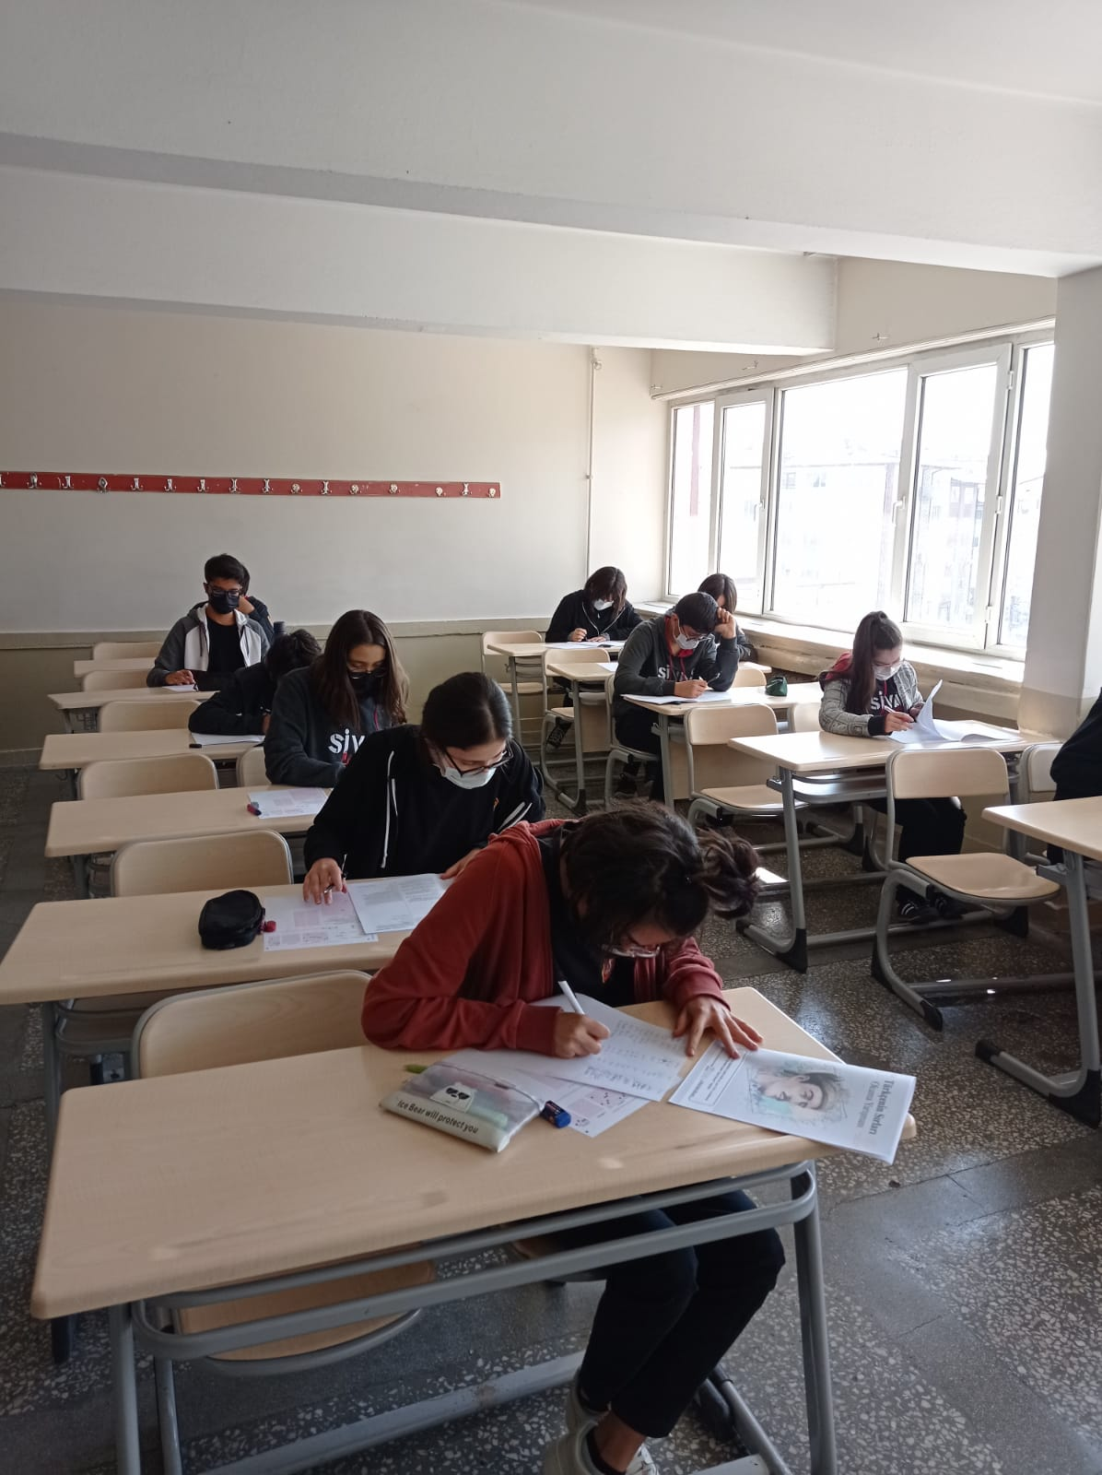

Slide 8
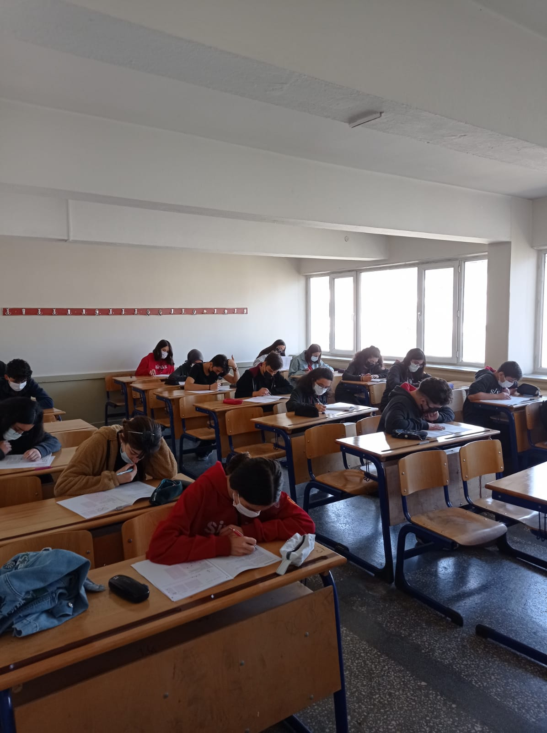

Slide 9
Apart from the book reading competitions, "Book Reading Ring" activities are planned at the grade level at our school. Within the scope of this activity, first of all, a reading circle will be formed from the students in the class. Again, the books determined by the students in the ring will be read by each student once a month, and the read book will be left to the next student in the ring the next month. In this way, as many books as the number of students in the ring will be read. In some parts of our reading activity, the interactive book reading technique will be used, and students will be asked to complete an unfinished book, to make cartoons or illustrations of its heroes, and to animate a certain part of the book.

Slide 10
Our primary goal in this activity is to give students a habit of regular reading. In addition, we plan to improve the evaluation and critical reading skills of the students in our conversation about the books read every month. The fact that the conversations to be held not only in the classroom environment but also in the library, cultural center and historical mansions will allow the students to breathe different cultural atmospheres and to keep the books they read in their minds. In this context, thanks to the interactive reading activities that we will put into practice at regular intervals, students will have the opportunity to develop their creativity and use their imaginations.

